Slide 1
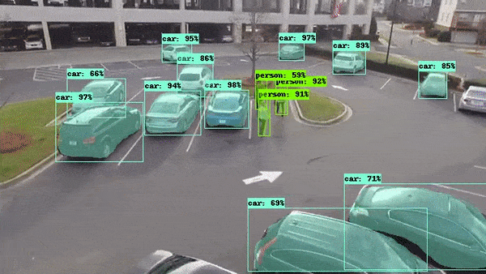
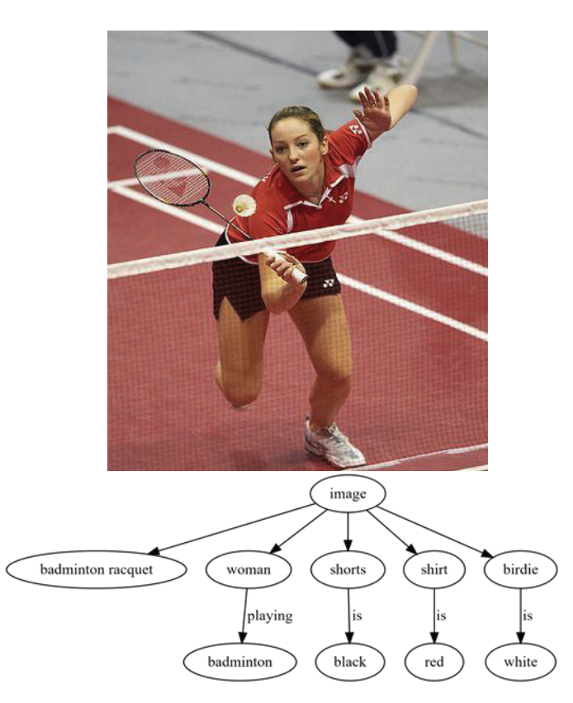
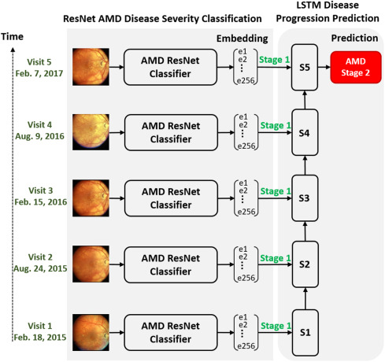
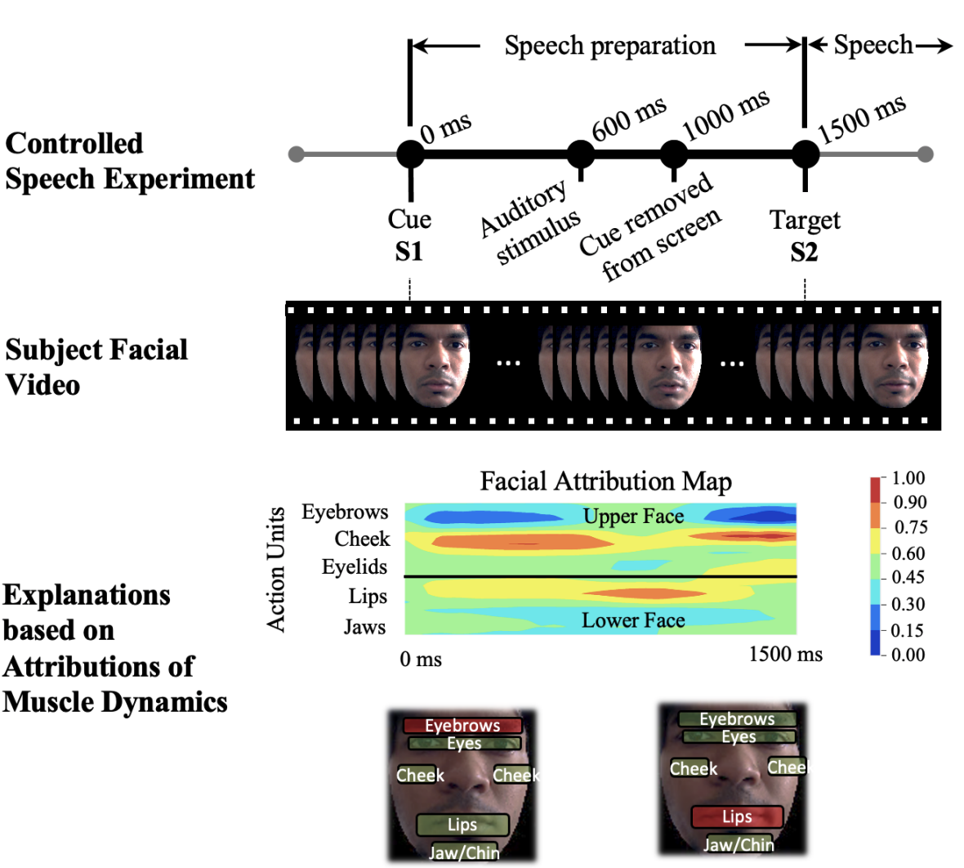
Deep Learning for Computer Vision
Sahba, Amin, et al. "Image graph production by dense captioning." 2018 World Automation Congress (WAC). IEEE, 2018.
Das, Arun, et al. "Interpretable Self-Supervised Facial Micro-Expression Learning to Predict Cognitive State and Neurological Disorders." Proceedings of the AAAI Conference on AI. Vol. 35. No. 1. 2021.
Das, Arun, et al. "Distributed machine learning cloud teleophthalmology IoT for predicting AMD disease progression." Future Generation Computer Systems 93 (2019): 486-498.

Slide 2
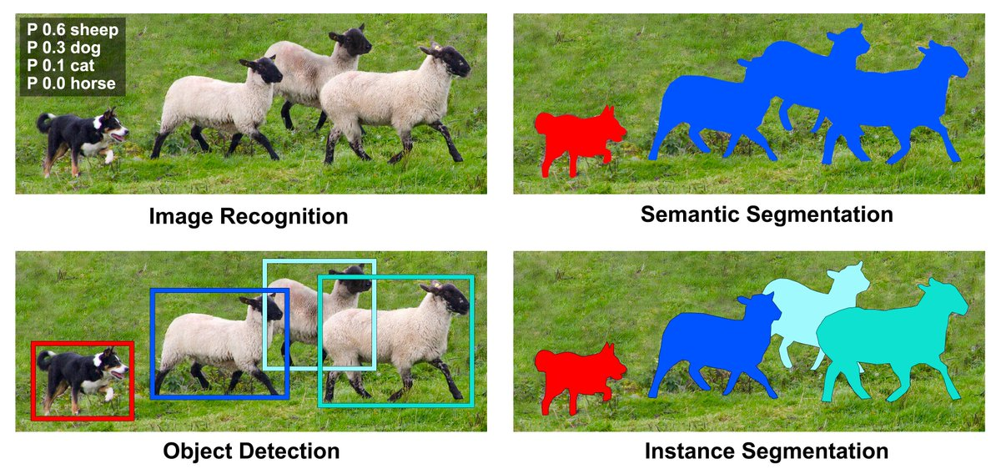
Major Applications of DL for Computer Vision
Christoph Reike, Deep Learning for Instance Segmentation of Agricultural Fields, Master thesis, 2017.

Slide 3
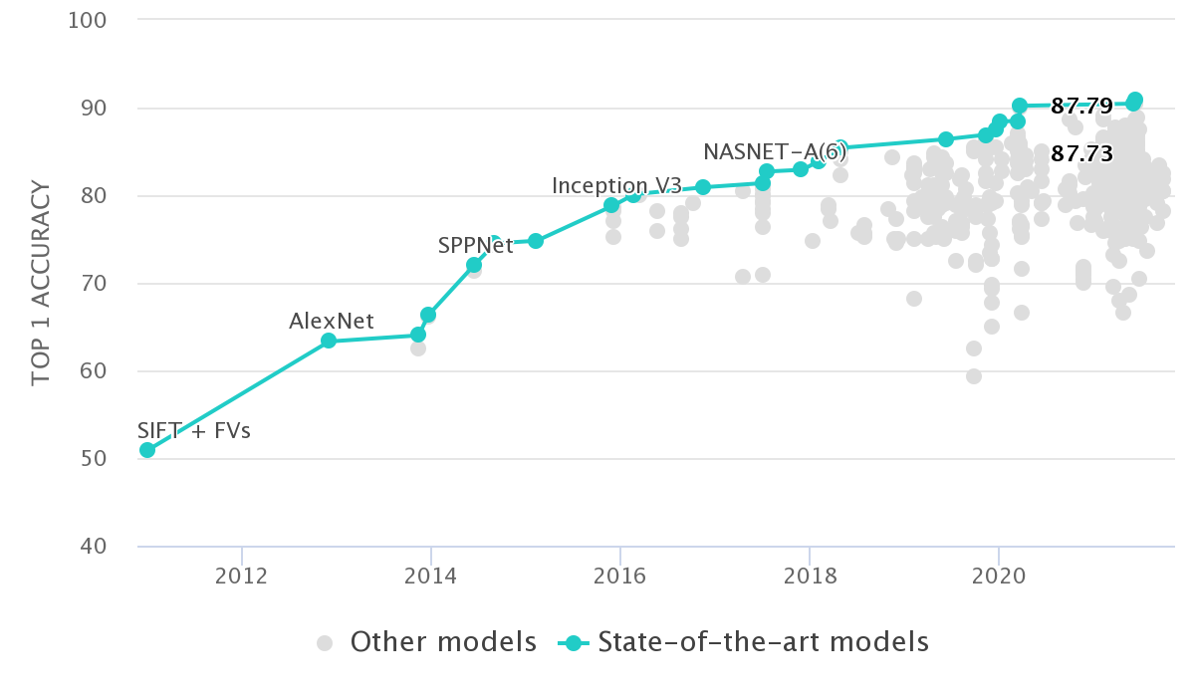
Huge Models, Lots of Parameters!
2.44B
It is not feasible anymore to train large neural networks with the amount of compute most of us have access to. It might take many days or weeks to train large neural networks with millions or billions of parameters.
1.84B
30M
66M
377M
60M
https://paperswithcode.com/sota/image-classification-on-imagenet

Slide 4
Transfer Learning
Transfer Learning is a way to transfer the representations learned by a neural network on one domain of data to another. By doing so, we enable the neural network to start optimization from a good set of weights which are already tuned to produce good accuracy for the initial problem for which it was trained. If we name the initial task Task-A and the new task Task-B, the goal of transfer learning is to train a model to be good at Task-B while starting the model with the parameters trained during Task-A. For example, a CNN trained on ImageNet dataset to classify between 1000 different classes can be used to further improve the accuracy of a new model to predict flowers in Task-B.

Slide 5
When does transfer learning work?
Your old task A (Inception + ImageNet) and new task B (Flower dataset) should have the same input types; in this case Images.
You have a lot of data for task A and less for task B; in this case, millions of images for task A and 10,000 for task B.
You have the intuition that features learned in the lower layers (low-level features) of task A might help in task B.
https://www.linkedin.com/pulse/transfer-learning-fine-tuning-lets-discuss-arun-das/

Slide 6
How many layers to transfer (what parameters to transfer) ?
Tough question! I would start by looking at the datasets for both task A and task B and ask the following questions:
Are data for task A and task B similar, at least to us (humans)?
Are there, visually, enough features that the two datasets share or could share?
If the answers to this question is somewhere in the range of - "The datasets share a lot in common, the many categories in dataset A could really help in learning representations from dataset B" or "The dataset A already have a lot of images and intuitively it should give good result for dataset B", then do a technique called “Fine Tuning”, else do transfer learning on the entire network.
“Fine Tuning”, generally, is when we freeze the weights of all the layers of the pre-trained neural networks (on dataset A) except the penultimate layer and train the neural network on dataset B, just to learn the representations on the penultimate layer. We usually replace the last (softmax) layer with another one of our choice (depending on the number of outputs we need for the new problem, so in our case say we have data for 10 different cars, we should replace the last softmax layers with a 10 node softmax layer).

Slide 7
General Steps for Transfer Learning
The general steps are: (1) take Inception trained on ImageNet, (2) freeze all layers but the penultimate layer (3) replace the last layer and (4) train the penultimate and softmax layer on car dataset to learn about car features.
Fine Tuning works well because the network already learned so much about edges, curves and objects from the ImageNet dataset (from millions of images) and can relate them to the newer dataset. If the network did not learn during Fine Tuning, you might want to 'unfreeze' some more layers. Say freeze all layers except the last 3 layers and train again. See how the networks behaves and reiterate. You could also try to initialize the network with the pre-trained weights and train the whole network again without freezing any layers. This is what we often mean when we say 'transfer learning' - initializing the whole network with pre-trained weights and training the whole network again on the new dataset.

Slide 8
State-of-the-Art CNN Model Examples
Object Detection: CenterNet HourGlass104
https://colab.research.google.com/github/tensorflow/hub/blob/master/examples/colab/tf2_object_detection.ipynb
Explore more at Tensorflow Hub: https://tfhub.dev/

